Slide 1

THE 7CS OF COMMUNICATION

Slide 2
Pre-viewing
What do you think are the key principles of effective communication?
What do you think are the “7 Cs of communication”?

Slide 3
Match the following terms with their definitions:
Term | Defintion
1. Clear | a. containing all necessary information
2. Concise | b. specific and supported by facts
3. Concrete | c. message purpose is understandable
4. Correct | d. respectful and audience-aware
5. Coherent | e. accurate and error-free
6. Complete | f. brief and direct
7. Courteous | g. logically organized
c
f
b
e
g
a
d

Slide 4
Watch the following video, then answer the questions below:
https://www.youtube.com/watch?v=BkGJ8B85SKE

Slide 5
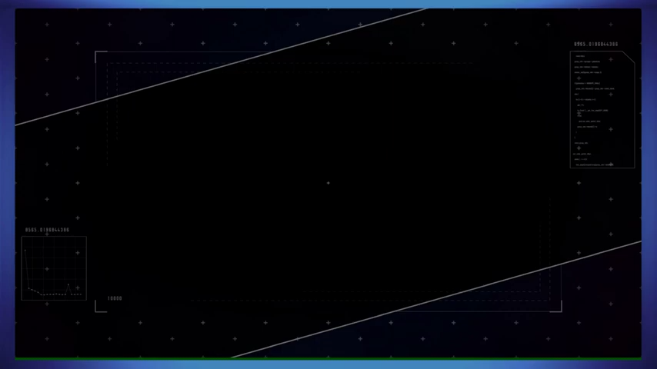

Slide 6
While-viewing
Watch the video, and fill in the gaps in the following table:
C-term | Definition in your own words | Example from video/ your own example

Slide 7
Answer Key
C-term | Definition in your own words | Example from video/ your own example
Clarity | Make your message easy to understand; avoid vague or confusing words. | “Submit the report by Friday at 3 PM.” (clear)
Conciseness | Keep it short and to the point; avoid unnecessary words. | Instead of: “I was wondering if maybe you could possibly send me the file?” → “Please send me the file.”
Concreteness | Use specific facts, figures, or examples; avoid being too general. | “Our sales increased by 20% last quarter” (concrete) instead of “We did well.”
Correctness | Use correct grammar, spelling, and facts; be accurate. | Wrong: “The meeting is on Thusday.” Correct: “The meeting is on Thursday.”

Slide 8
Answer Key Cont’d
Coherence | Keep ideas well-organized and logical; ensure the message flows smoothly. | “First, let’s discuss the budget. Then we’ll talk about marketing. Finally, we’ll plan the launch.”
Completeness | Give all necessary details so the receiver can act on the message. | Incomplete: “Meet me at 7.” Complete: “Meet me at Starbucks downtown at 7 PM.”
Courtesy | Be respectful and polite; consider the receiver’s feelings. | Instead of: “Send me the report now!” → “Could you please send me the report by this afternoon?”

Slide 9
Post-viewing
In groups of 3, discuss the following:
Which “C” do you see most frequently used well in presentations?
Clarity. Most presenters try to make their main idea clear to the audience. They usually explain their topic in simple language so everyone can follow

Slide 10
Which is most often neglected?
Conciseness. Many presenters include too many details or repeat the same points, which makes the presentation long and less engaging.
Another common one: Courtesy. Sometimes presenters don’t pay attention to tone or body language, which can feel rude or unprofessional.

Slide 11
Why might some be harder for speakers to follow?
Completeness can be hard because presenters may forget to include background information or assume the audience already knows certain details.
Coherence is challenging if the presenter hasn’t planned or structured the talk well.
Conciseness is difficult because speakers may feel nervous and start talking too much or going off-topic.

Slide 12
Scenarios
The following situations break one of the 7Cs of communication. In pairs:
Identify the problem
Suggest a solution to resolve it
Scenario: A manager tells the team: “We need to handle that thing soon because it’s really important for the project.”
Problem: Clarity The message is vague. What is “that thing”?
Suggested solution : Clearly state what “that thing is”, a problem, for example.

Slide 13
2. Scenario: A student giving a presentation says: “Basically, what I want to say, in other words, is that the point I am trying to make is that studying is important because if you study, you will learn more, and learning more is important.”
Problem: Conciseness (Too wordy / repetitive)
Suggested solution : Be conscice and to the point. Don’t use unnecessary repetition

Slide 14
3. Scenario: A company brochure states: “Our product is amazing, the best, and will definitely improve your life in many ways.”
Problem: Concreteness (Too abstract / lacks evidence)
Suggested solution: Use concrete facts and examples to make it more convincing

Slide 15
4. Scenario: A student emails their professor: “Dear Dr. John, I will meat you on Thusday for the exam review.”
Problem: Correctness (Inaccurate or wrong). Spelling and grammar errors → “meet,” “Thursday.”
Suggested solution: Check your message for any typos, or grammatical mistakes.

Slide 16
5. Scenario: A speaker says in a presentation: “Today I will talk about exercise. Exercise is important for health. By the way, I also like pizza. Running helps burn calories. People should sleep enough hours too.”
Problem: Coherence (Poor organization). Random ideas, no logical flow.
Suggested solution: Organize your ideas. Rehearse a lot before giving a presentation.

Slide 17
6. Scenario: A text message to a friend: “Meet me at the place at 7.”
Problem: Completeness (Missing important details). Which place? Missing location details.
Suggested solution: Provide all necessary details

Slide 18
7. Scenario: An employee writes to a colleague: “Send me the report now. You’re always late and it’s annoying.”
Problem: Courtesy (Rude or insensitive). Tone is disrespectful, lacks courtesy.
Suggested solution: Be courteous and address other people politely.

Slide 19
C. In small groups, students create a short 1-minute presentation on a topic of their choice, intentionally incorporating at least three of the 7 Cs. The audience listens and identifies which “Cs” are effectively demonstrated, with constructive feedback.

